Slide 1
WORKSHOP ON ARTIFICIAL INTELLIGENCE IN BASIC RESEARCH AND DRUG DEVELOPMENT
University of Nebraska Medical Center · 28–29 April 2026
Current and Future Applications of
Scientific Machine Learning in Drug Development
Bridging mechanism and data
Amit Roy, PhD
VP Scientific & Strategic Consulting, Pumas-AI

Slide 2
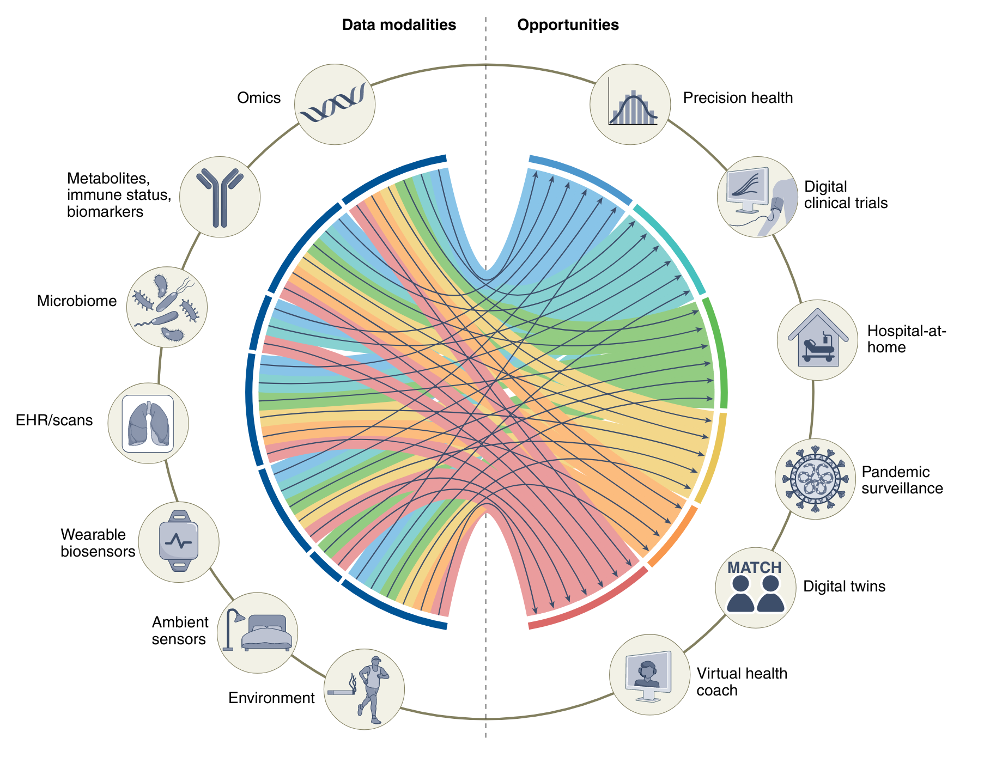

THE CHALLENGE
Drug development is long, expensive, and increasingly data-rich
10–15
years from
discovery to approval
$2.6 B
average capitalized
cost per approved drug
~10%
of phase-1 candidates
that reach patients
Sources: DiMasi JA, J Health Econ 2016 · FDA CDER · Acosta JN et al., Nat Med 2022 (multimodal data graphic)
SciML in Drug Development · Amit Roy · University of Nebraska, April 2026
2 / 37
Notes:
MEANWHILE, THE DATA WE COLLECT KEEPS GROWING
Most clinical-trial data is never fully exploited by conventional analyses.
AI/ML opens the door to patterns we couldn't see before.
Conventional tools were built for hypothesis-focused analyses on small data slices — AI/ML is built for the rest.

Slide 3
PART 01
What is Scientific
Machine Learning?
Embed differential equations, conservation laws, and biology directly into ML models —
so they only learn what you don't already know.

Slide 4
DEFINITIONS
AI, machine learning, deep learning — nested ideas
Artificial Intelligence (AI)
Any technique that lets machines mimic human cognition — including expert systems.
Artificial Intelligence
Machine Learning
Machine Learning (ML)
Deep Learning
Algorithms that learn from data — no hand-coded rules per pattern.
Deep Learning (DL)
Multi-layer neural networks — especially good with images, sequences, and time courses.
SciML in Drug Development · Amit Roy · University of Nebraska, April 2026
4 / 37

Slide 5




ML PARADIGMS
Four families of machine learning, all useful in pharma
Supervised
Unsupervised
Labeled data — each example carries a known outcome.
No labels — find structure, clusters, or low-dim representations.
Example: Predicting responders from baseline covariates
Example: Patient subtyping from omics + phenotypes
Semi-supervised
Reinforcement
Small labeled + large unlabeled set — common in EHR data.
An agent learns from feedback by acting on its environment.
Example: Adverse-event signal mining
Example: Adaptive dosing and trial designs
Adapted from Liu Q et al., CPT 2020 (DOI: 10.1002/cpt.1771)
SciML in Drug Development · Amit Roy · University of Nebraska, April 2026
5 / 37
Notes:
Strengths of pure ML
Flexible & pattern-finding
Scales to high-dim inputs
Limitations of pure ML
Data-hungry
Hard to extrapolate

Slide 6



DEFINITION
SciML, in one sentence
Embed differential equations, conservation laws, and biology directly into machine-learning models — so they only learn what you don't already know.
Structure-preserving
Data-efficient
Extrapolation-aware
Model is constrained by scientific understanding
Mechanistic knowledge carries the load where data is thin
Behaves sensibly outside the training range — needed for dose projection.
SciML in Drug Development · Amit Roy · University of Nebraska, April 2026
6 / 37

Slide 7
METHODS
The SciML toolkit at a glance
Neural ODEs
Universal DEs (UDEs)
dx/dt = NN(x, t; θ)
dC/dt = -(CL/V)*C + NN(C, X; θ)
Neural network parameterizes the ODE right-hand side. Learn dynamics from time-course data.
Keep your mechanistic model. Replace only the unknown term with a small neural net. The pharma workhorse.
Physics-Informed NNs
Operator learning
loss = data MSE + ODE residual
G_θ : (params, inputs) -> trajectory
Train a neural net to satisfy a differential equation
Learn the map from parameters to full simulation outputs
SciML in Drug Development · Amit Roy · University of Nebraska, April 2026
7 / 37

Slide 8
THE WORKHORSE FOR PHARMA
Universal Differential Equations (UDEs)
dC/dt = − (CL/V) · C + NN(C, covariates ; θ)
what we know (mechanism) + what we don't (small neural net)
Preserve what you know
Discover what you don't
Requires less data
PK structure, receptor binding, PBPK — kept verbatim.
Every trusted equation stays in place.
Non-linear feedback, saturation, circadian terms emerge as learned functions you can inspect — and even symbolically regress into a closed form.
Most of the model is already right. The neural net only needs to learn a small correction — feasible with phase-1 / phase-2 datasets.
Rackauckas C et al., 2020 (arXiv:2001.04385) — Universal Differential Equations for Scientific Machine Learning
SciML in Drug Development · Amit Roy · University of Nebraska, April 2026
8 / 37

Slide 9
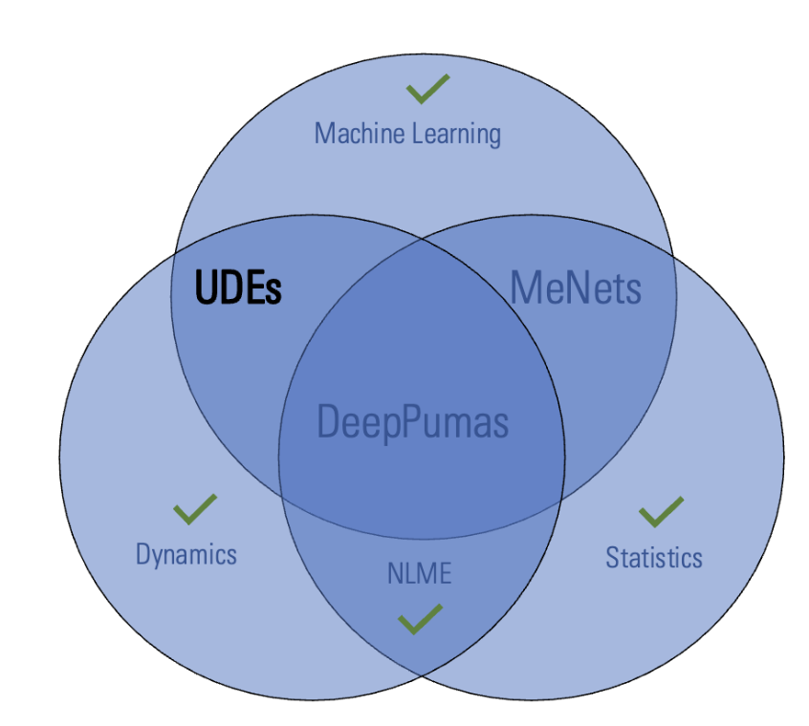
DEFINITION
DeepNLME — UDEs meet nonlinear mixed-effects models
WHAT GOES INTO IT
Dynamics
Mechanistic ODEs — what we already know about PK/PD
Machine learning
DeepNLME
Neural surrogates — what we don't yet know
NLME / statistics
Population fixed + random effects — between-subject variability
DeepNLME = UDE structural form + neural mixed-effects + classical NLME estimation.
UDE: Rackauckas C, 2021 (arXiv:2001.04385) · Term coined: Korsbo N, PAGE Workshop 2024
SciML in Drug Development · Amit Roy · University of Nebraska, April 2026
9 / 37

Slide 10
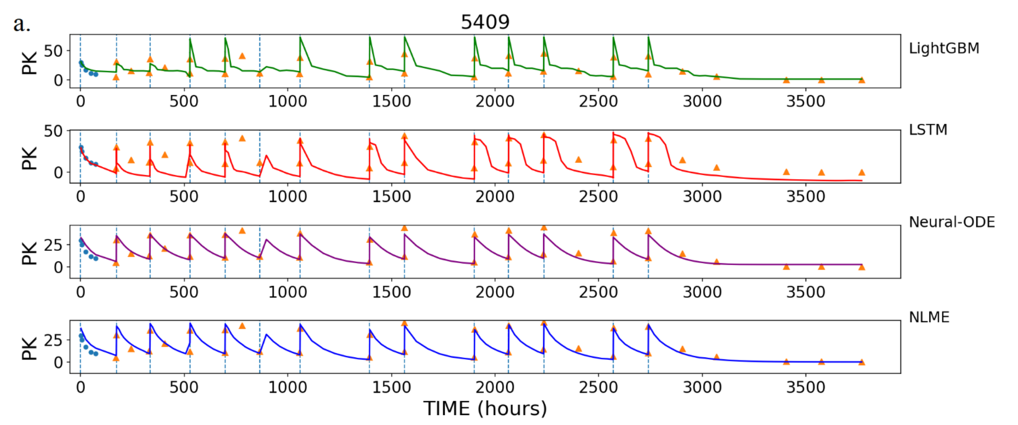
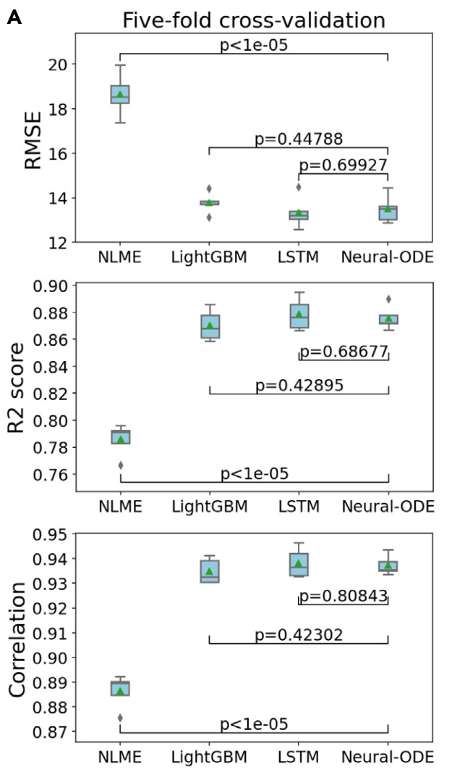
A WORD OF CAUTION
ML metrics can look better — even when the model is wrong
IV PK fit by three pure-ML models (LightGBM, LSTM, Neural-ODE) and a conventional population PK (NLME) model.
Better RMSE / R² / correlation — but some of the fits (LSTM and LightGBM) violate physiology
Lu J et al., iScience 2021 (DOI: 10.1016/j.isci.2021.102804)
SciML in Drug Development · Amit Roy · University of Nebraska, April 2026
10 / 37
Notes:
We applied three ML/DL approaches for clinical PK prediction: a novel variant of neural-ODE, LSTM neural network (Bianchi et al., 2017), and lightGBM (Ke et al., 2017). LSTM is a base learner that was designed specifically for time course prediction tasks (Hochreiter and Schmidhuber, 1997). LightGBM is a popular tree-based algorithm
Data from over 600 patients
Trastusumab-DM1 ADC … HER2-targeted antibody-drug conjugate
Therefore, we focus on the comparison of ML/DL approaches in their ability to learn from PK data generated from one dosing regimen, to predict an unseen regimen
Trained ML with data from 1 dosing regimen and used it to predict C-T from another dosing regimen

Slide 11
PART 02
Example of SciML UDE in action —
describing drug absorption
Replacing simplistic functional forms with a neural network — and seeing what that buys.

Slide 12
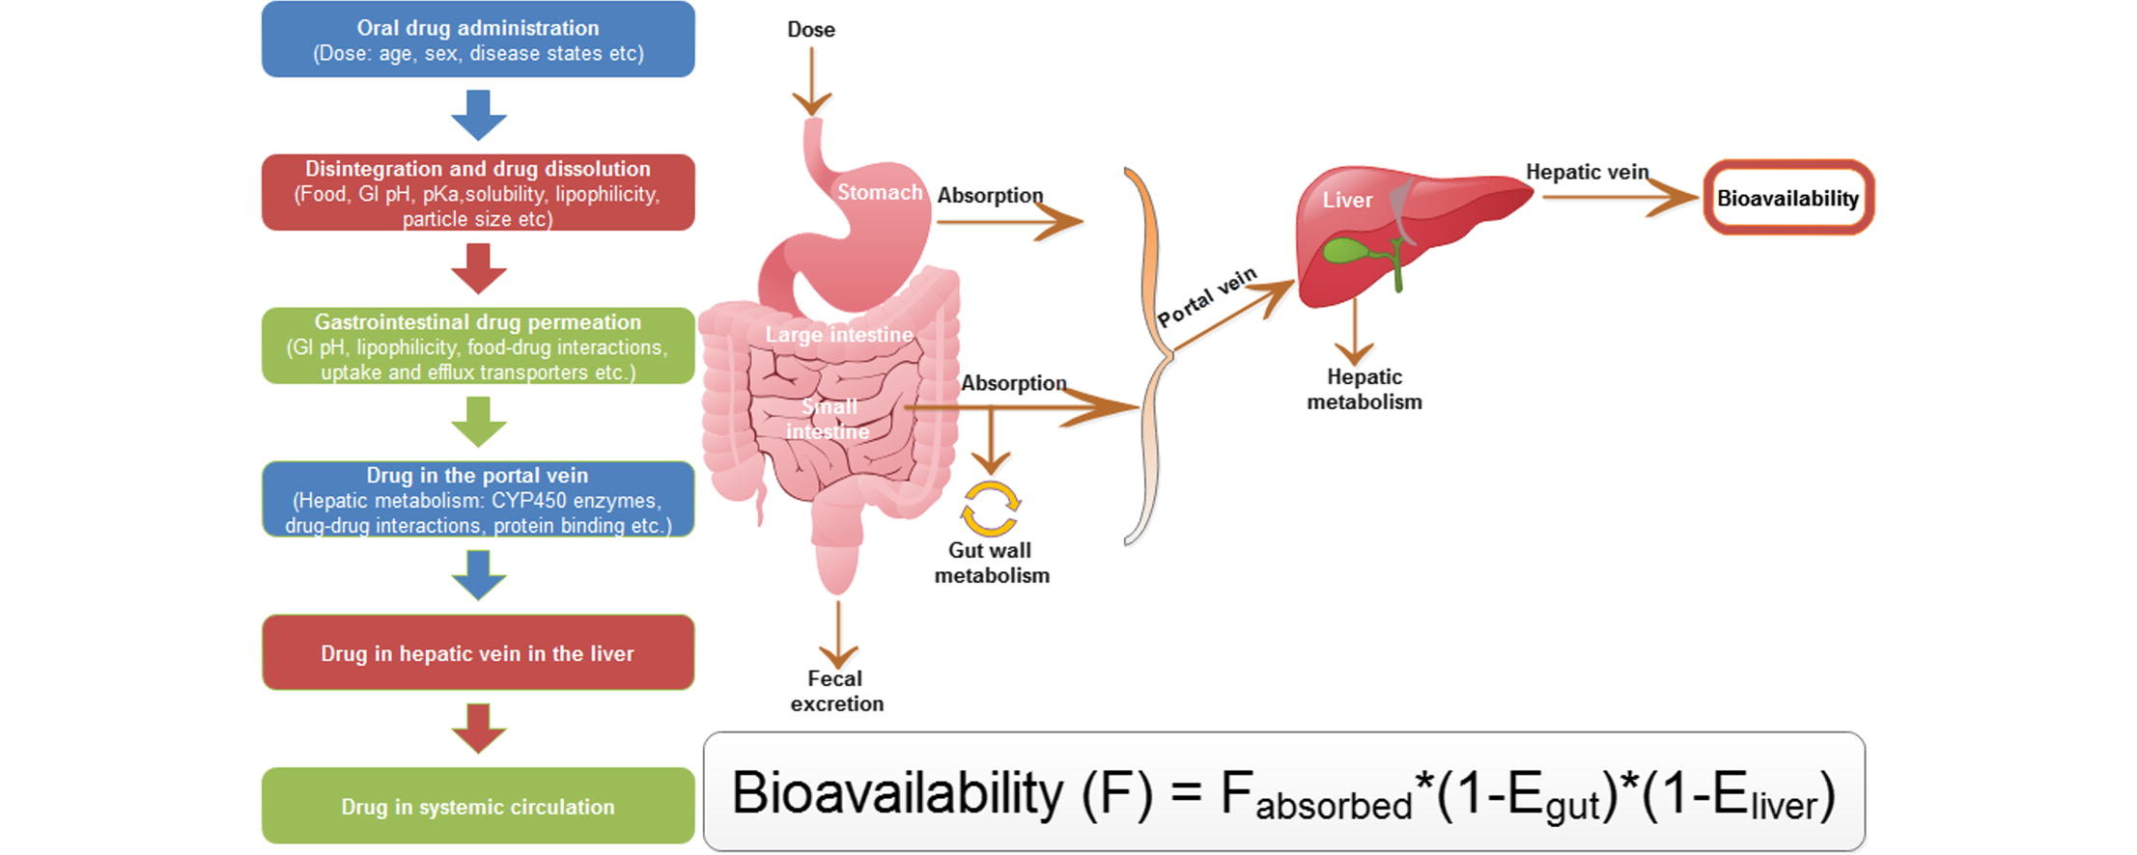

DRUG ABSORPTION
A complex process — usually modeled simplistically
First-order absorption — a single rate constant Ka summarises a multi-step physiological cascade.
Graphic taken from: Abuhelwa AY et al., Eur J Pharm Biopharm 2017 (DOI: 10.1016/j.ejpb.2016.11.034)
SciML in Drug Development · Amit Roy · University of Nebraska, April 2026
12 / 37

Slide 13
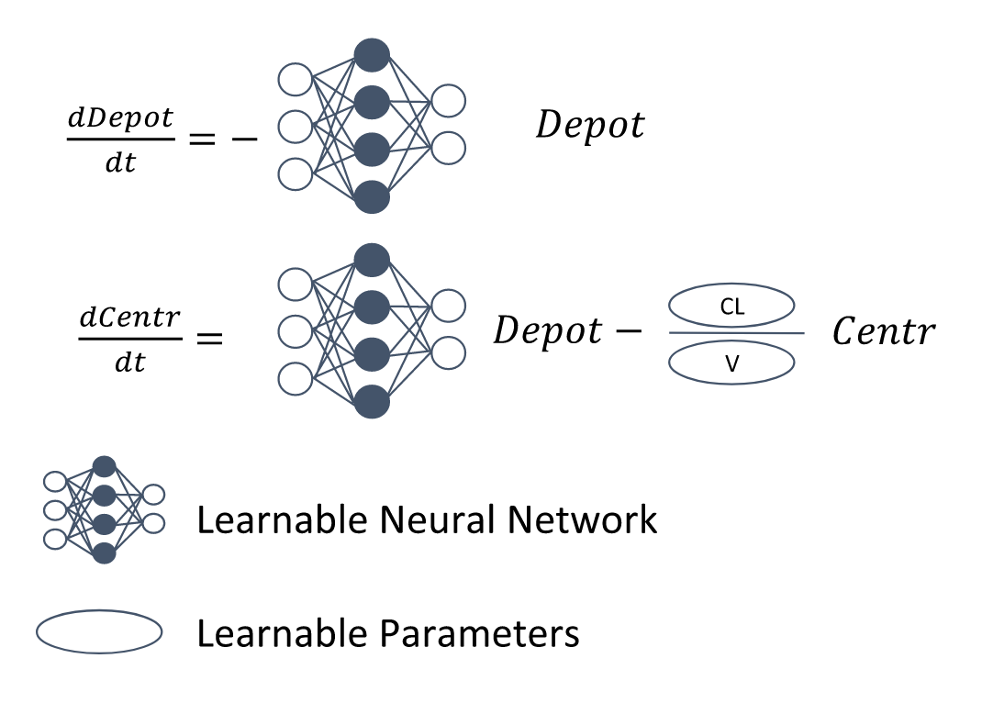
THE SCIML ANSWER
Replace the fixed absorption form with a small neural network
Mechanism (clearance, volume) is preserved — the neural network only learns the unknown absorption.
Valderrama D et al., CPT:PSP 2024 (DOI: 10.1002/psp4.13054)
SciML in Drug Development · Amit Roy · University of Nebraska, April 2026
13 / 37

Slide 14
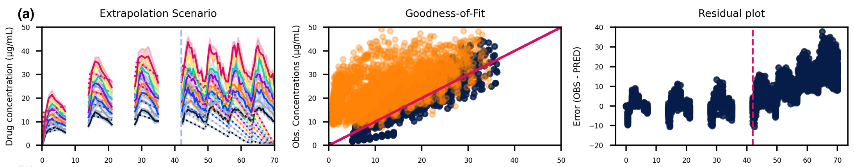
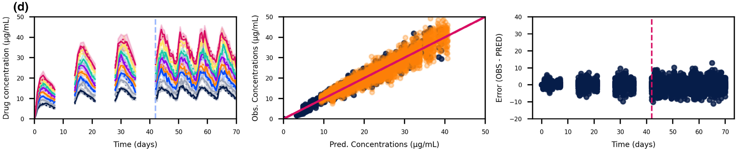
THE RESULT
Mechanistic constraints in SciML enable extrapolation
NEURAL-ODE (no mechanism)
Interpolation | Extrapolation
SCIML (mechanism + neural correction)
Valderrama D et al., CPT:PSP 2024 (DOI: 10.1002/psp4.13054) — extrapolation to unseen times
SciML in Drug Development · Amit Roy · University of Nebraska, April 2026
14 / 37

Slide 15
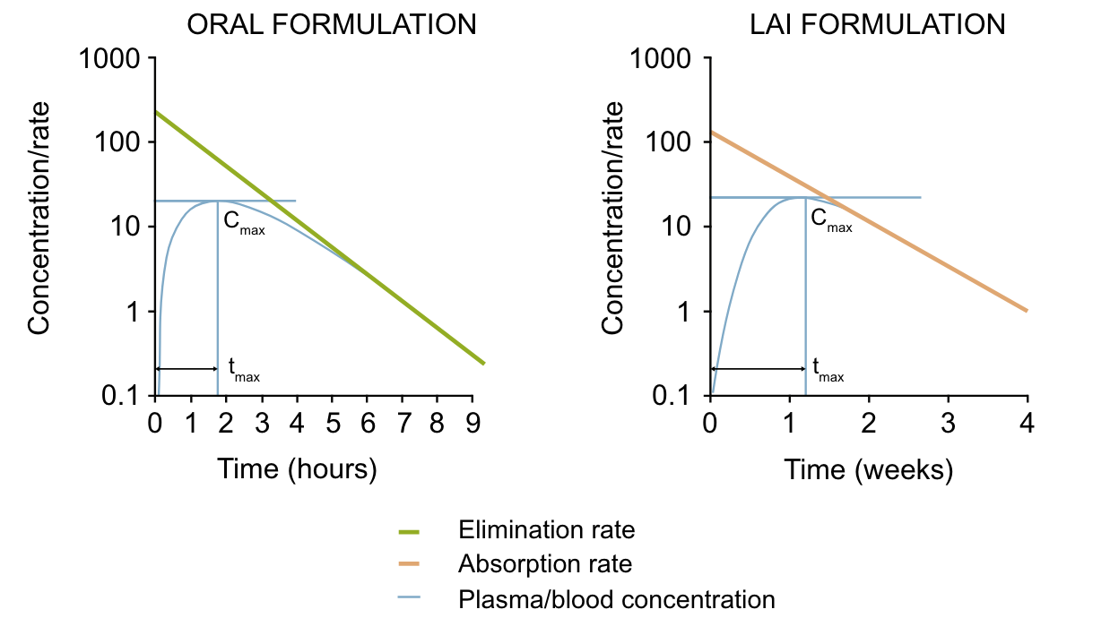
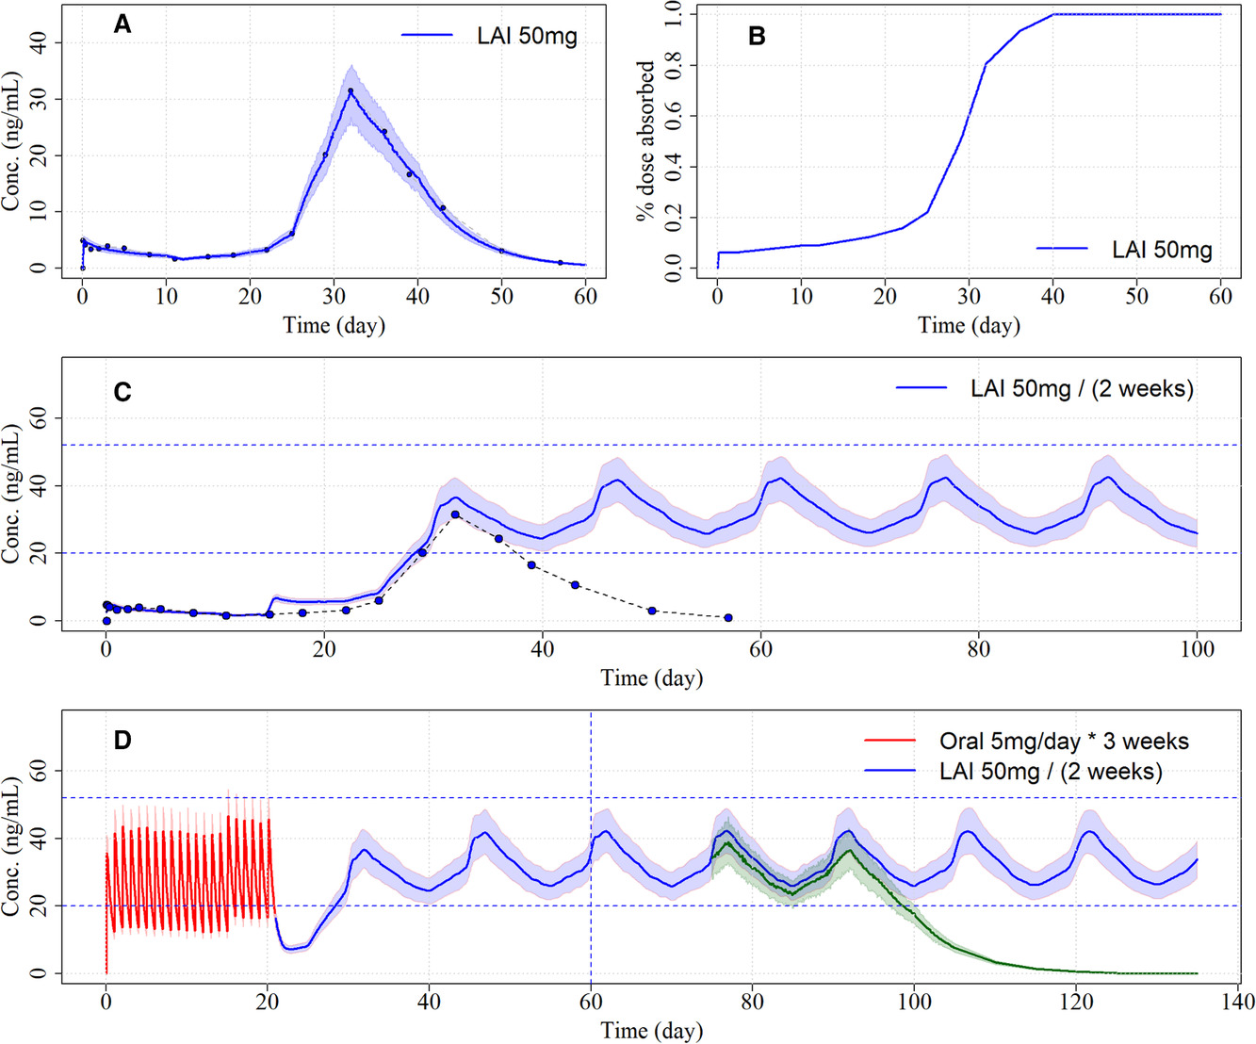
WHY THIS MATTERS
Long-acting injectables — where SciML may be the only viable option
LAI absorption defies a single rate constant — UDE-style models capture the multi-phase kinetics.
Correll CU et al., CNS Drugs 2021 (DOI: 10.1007/s40263-020-00779-5) · Gomeni R et al., J Clin Pharmacol 2017 (DOI: 10.1002/jcph.1842)
SciML in Drug Development · Amit Roy · University of Nebraska, April 2026
15 / 37

Slide 16
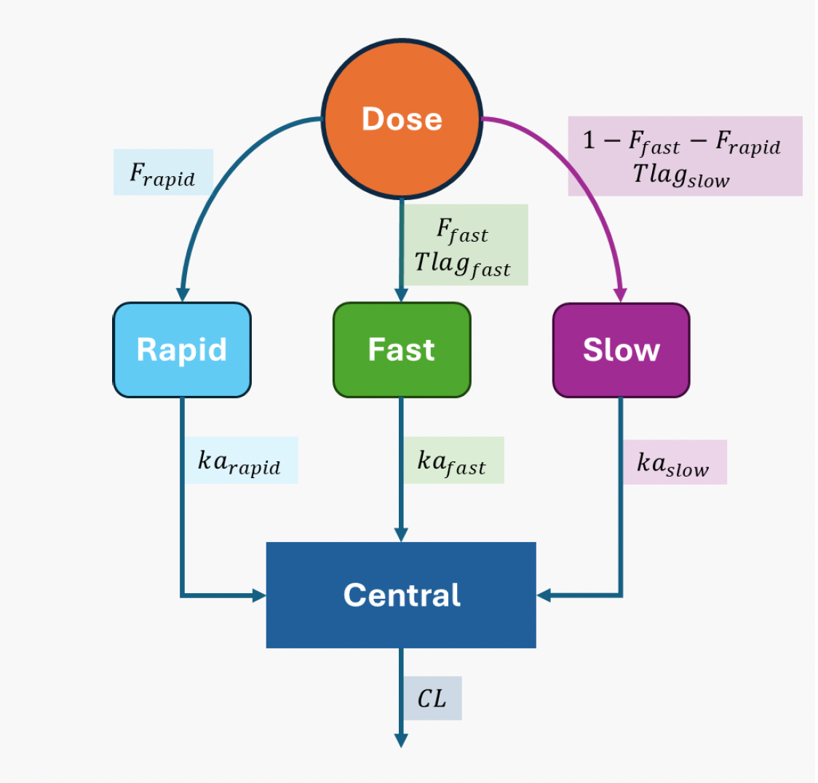
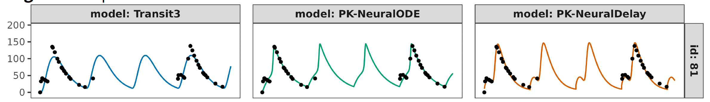
PROOF OF PRINCIPLE
SciML captures multi-phase absorption that a parametric model misses
SIMULATION MODEL
WHAT WE DID
3-pathway (rapid + fast + slow) absorption, fit by Transit3 and two SciML models — PK-NeuralODE and PK-NeuralDelay.
WHAT WE FOUND
Transit3 — Missed the multi-peak structure
PK-NeuralODE — Captured elimination but missed peak heights
PK-NeuralDelay — Most consistent fit across timepoints & subjects
FITTED MODELS
Krishnan SM et al., A Neural-Based Framework for Modeling Delayed and Multi-Phase Drug Absorption — PAGE 2025, Thessaloniki, Greece
SciML in Drug Development · Amit Roy · University of Nebraska, April 2026
16 / 37

Slide 17
PART 03
Additional applications of ML in MIDD:
Beyond PK

Slide 18
FRAMING · GLOBAL REGULATORY CONTEXT
Model-Informed Drug Development — and why it has global reach
WHAT IS MIDD?
ICH M15 · DRAFT
Mathematical models — of drug, disease, and trial — used to inform development decisions: dose, design, label, and extrapolation.
Draft international guideline on MIDD principles (2024).
FDA · USA
EMA · Europe
Dose & exposure
Trial design
PMDA · Japan
Selection, justification
Endpoints, adaptive designs
Health Canada
MHRA · UK
Special populations
External controls
NMPA · China
Pediatric, renal, hepatic
Augmenting trials with RWE
Globally accepted — not just FDA.
SciML is the next chapter of MIDD — same principles, more powerful tools.
ICH M15 Draft Guideline on the Principles of Model-Informed Drug Development (2024) · ich.org
SciML in Drug Development · Amit Roy · University of Nebraska, April 2026
18 / 37

Slide 19
REGULATORY UPTAKE
Reported uses of ML in FDA submissions
FOUR HIGH-FREQUENCY USE PATTERNS
ML SUBMISSIONS
TO FDA
Drug response × baseline factors
1
Predict who responds from demographics, labs, genomics, imaging.
300+
2
Early → late response linkage
Use week-2 biomarker dynamics to forecast week-12 outcomes.
AI/ML-related submissions reported by FDA across drugs and biologics — and the curve is still accelerating
3
Patient subgroups by risk-benefit
Identify populations with differentiated efficacy or safety profiles.
4
Disease progression from history
Build natural-history models from registries and external controls.
Liu Q et al., CPT 2020 (DOI: 10.1002/cpt.1771); FDA Discussion Paper, 2023
SciML in Drug Development · Amit Roy · University of Nebraska, April 2026
19 / 37

Slide 20
REGULATORY LANDSCAPE
What the Health Authority agencies are saying — and asking for
FDA
AI/ML in drug development discussion paper (2023)
Transparency, model lifecycle management, and human oversight.
FDA
MIDD Paired Meeting Programs
Active sponsor engagement — hybrid ML models for dose, label, pediatrics.
EMA
Reflection paper on AI in the medicinal lifecycle (2024)
Risk-based approach — data governance, bias, validation.
ICH
ICH M15 — Model-Informed Drug Development
Harmonized guidance; explicitly admits ML/SciML approaches.
FDA · HC · MHRA
Good Machine Learning Practice — 10 guiding principles
Now widely adopted for ML in drug development too.
SciML in Drug Development · Amit Roy · University of Nebraska, April 2026
20 / 37

Slide 21
CASE 01 · DISEASE PROGRESSION
Parkinson's disease modeling with DeepNLME
CHALLENGE
APPROACH
OUTCOME
MDS-UPDRS has 65 items spanning motor exam and daily living. Standard progression models impose rigid linear or Emax shapes — covariates like age and baseline severity interact in ways those forms can't capture.
DeepNLME with a neural-network covariate model embedded in the structural ODE. Mechanistic structure preserved; the NN learns how covariates modulate progression rate.
Better longitudinal fit than benchmark models, with interpretable rate parameters. The learned covariate function reveals nonlinear age × baseline interactions standard NLME misses.
MDS-UPDRS: Movement Disorder Society-sponsored Unified Parkinson’s Disease Rating Scale
WHY IT MATTERS · Disease-progression models shape endpoints, sample sizes, and external-control design.
Ribba B et al., CPT 2024 (DOI: 10.1002/cpt.3253)
SciML in Drug Development · Amit Roy · University of Nebraska, April 2026
21 / 37

Slide 22
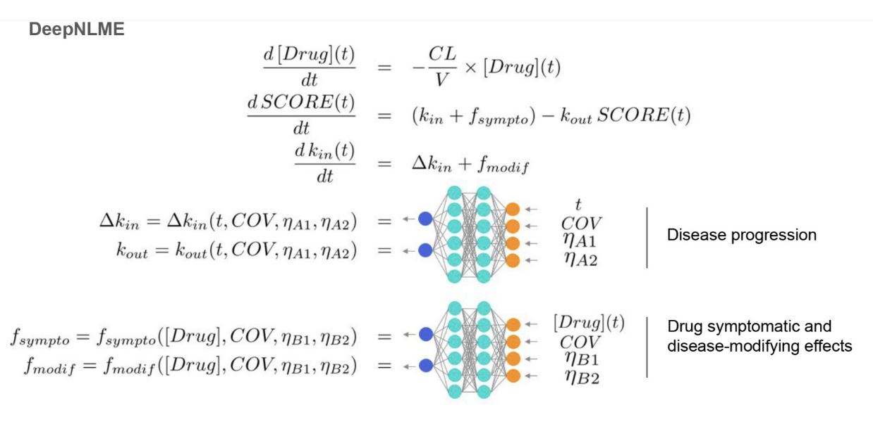
CASE 01 · DISEASE PROGRESSION
Parkinson's disease modeling with DeepNLME
Mechanism (drug PK, indirect-response PD) is preserved — neural networks fill in the parts we can't write down.
Ribba B et al., CPT 2024 (DOI: 10.1002/cpt.3253) · Disease-progression DeepNLME applied to Parkinson's disease (MDS-UPDRS).
SciML in Drug Development · Amit Roy · University of Nebraska, April 2026
22 / 37
Notes:
Parkinson’s Disease … MDS-UPDRS
Motor examinations + motor/non-motor aspects of daily living

Slide 23
CASE 02 · FROM SCIML TO AN INTERPRETABLE CLOSED-FORM NLME MODEL
AML hematology + symbolic regression
Sparse PD data
(WBC over weeks)
Train DeepNLME
(UDE)
Extract learned
function
Symbolic regression
→ closed form
Discovered NLME
model
THE STUDY
WHY IT MATTERS
23 AML patients on high-dose Ara-C with near-daily WBC counts.
Sparse data → discovered structural model, no manual hypothesis search.
Friberg myelosuppression — the textbook choice — can't capture every feedback in these data.
End product is a closed-form ODE — defensible and regulator-friendly.
DeepNLME fit better than Friberg. Symbolic regression recovered a closed-form expression.
Generalizes to any uncertain structural form (immunology, oncology PD).
Martensen CJ et al., bioRxiv 2024 (DOI: 10.1101/2024.06.17.599366)
SciML in Drug Development · Amit Roy · University of Nebraska, April 2026
23 / 37

Slide 24
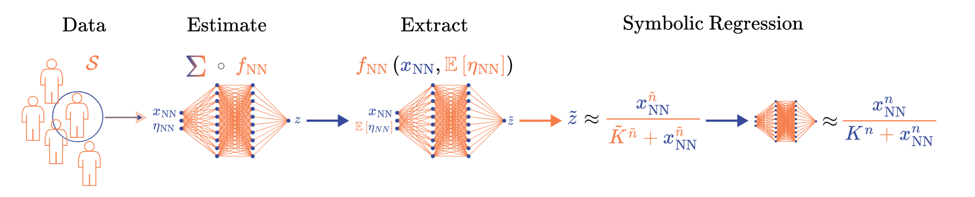
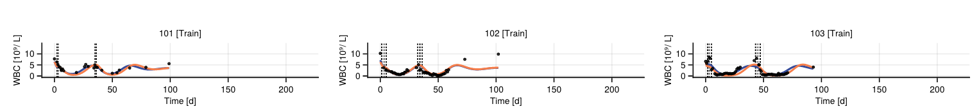
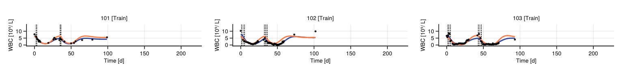
CASE 02 · FROM SCIML TO A CLOSED-FORM NLME MODEL
AML hematology + symbolic regression
SCIML MODEL
DISCOVERED NLME
Martensen CJ et al., bioRxiv 2024 (DOI: 10.1101/2024.06.17.599366) · AML hematology data
SciML in Drug Development · Amit Roy · University of Nebraska, April 2026
24 / 37
Notes:
Acute myeloid leukemia treated with high-dose cytarabine, along with the corresponding dataset
23 patients who 200 receive high-dose Ara-C infusion induction therapy resulting in complete remission. The white 201 blood cell count (WBC) is measured almost daily
DeepNLME model was able to describe the data better than the Friberg model as well the discovered model

Slide 25
CASE 03 · OPHTHALMOLOGY
DeepNLME for visual-acuity prediction (HARBOR trial)
CHALLENGE
APPROACH
OUTCOME
Best-corrected visual acuity (BCVA) is the regulatory endpoint for nAMD. A mechanistic NLME benchmark (Brizzi 2023) fits the average dynamics on the monthly-dosed training cohort — but generalizes poorly to PRN dosing and misses the minority of patients with declining vision.
DeepNLME — replace only the BCVA rate-of-change with a neural network that takes drug concentration, baseline acuity, age, and individual random effects. One-compartment drug PK is preserved. Trained by FOCE on 80% of the monthly cohort.
On the held-out PRN cohort, individual-prediction MAE decreased relative to the benchmark model
PRN = pro re nata, Latin for "as needed."
WHY IT MATTERS · DeepNLME generalizes beyond the training regimen — and the same workflow scales to longitudinal biomarkers.
Soubret A, Brizzi F et al., Charting New Paths in Ophthalmology with DeepNLME-Powered Predictive Modeling — ACoP 2024 (Roche / Pumas-AI) · HARBOR trial, N = 875
SciML in Drug Development · Amit Roy · University of Nebraska, April 2026
25 / 37

Slide 26
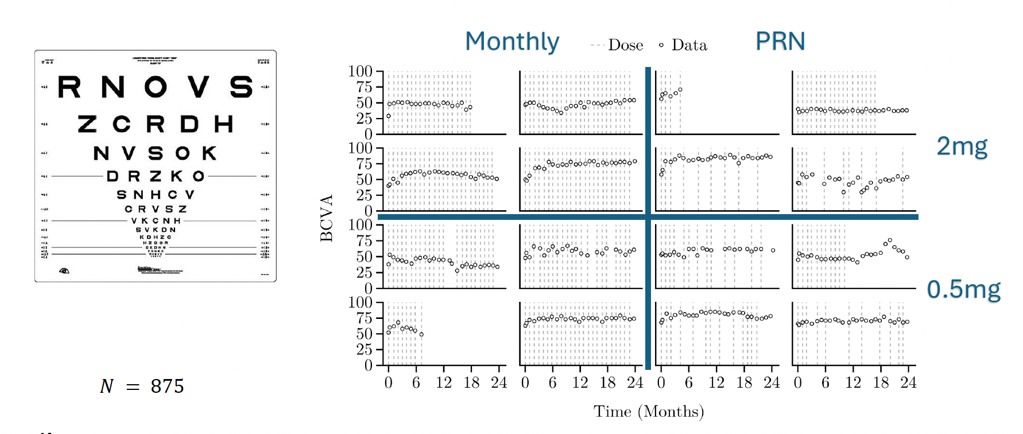
CASE 03 · OPHTHALMOLOGY · THE DATA
CASE 03 · OPHTHALMOLOGY · THE DATA
Longitudinal BCVA across 4 dosing cohorts (HARBOR, N = 875)
Longitudinal BCVA across 4 dosing cohorts (HARBOR, N = 875)
Wide variation across patients and dosing regimens — a stress test for population PK/PD models.
Wide variation across patients and dosing regimens — a stress test for population PK/PD models.
HARBOR phase III trial (NCT00891735) — ranibizumab in nAMD; 4 cohorts: 0.5 mg / 2 mg, monthly / PRN.
HARBOR phase III trial (NCT00891735) — ranibizumab in nAMD; 4 cohorts: 0.5 mg / 2 mg, monthly / PRN.
SciML in Drug Development · Amit Roy · University of Nebraska, April 2026
SciML in Drug Development · Amit Roy · University of Nebraska, April 2026
26 / 37
26 / 37

Slide 27
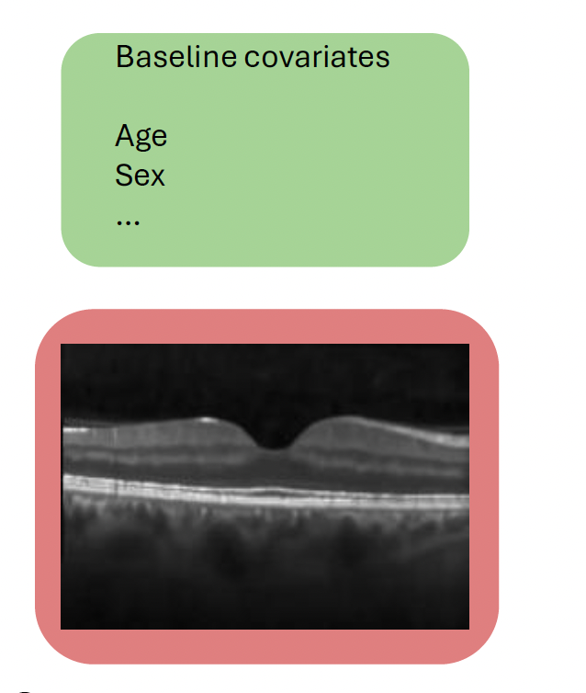
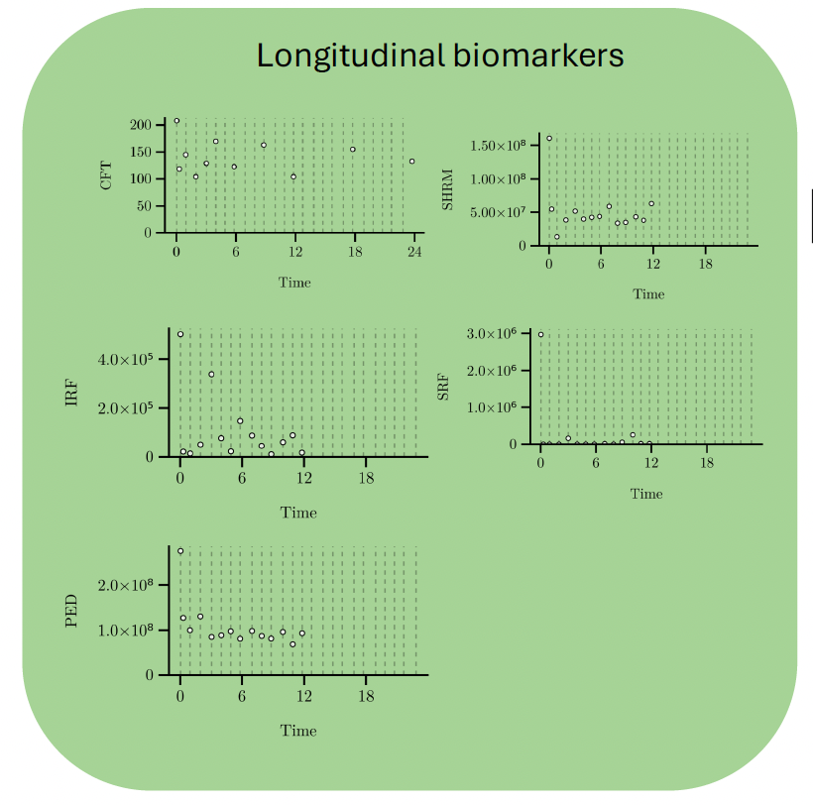
CASE 03 · OPHTHALMOLOGY · MODEL INPUTS
CASE 03 · OPHTHALMOLOGY · MODEL INPUTS
Predictor variables — baseline covariates and longitudinal biomarkers
Predictor variables — baseline covariates and longitudinal biomarkers
BASELINE
LONGITUDINAL BIOMARKERS
LONGITUDINAL BIOMARKERS
Optical Coherence Tomography (OCT) image.
A high-resolution, cross-sectional images of biological tissue produced by an imaging technique that's essentially the optical analog of ultrasound
Five OCT-derived biomarkers (CFT, SHRM, IRF, SRF, PED) feed the DeepNLME model alongside baseline age, sex, etc.
Five OCT-derived biomarkers (CFT, SHRM, IRF, SRF, PED) feed the DeepNLME model alongside baseline age, sex, etc.
Biomarkers (CFT, SHRM, IRF, SRF, PED) extracted from longitudinal OCT scans of HARBOR participants.
Biomarkers (CFT, SHRM, IRF, SRF, PED) extracted from longitudinal OCT scans of HARBOR participants.
SciML in Drug Development · Amit Roy · University of Nebraska, April 2026
SciML in Drug Development · Amit Roy · University of Nebraska, April 2026
27 / 37
27 / 37

Slide 28
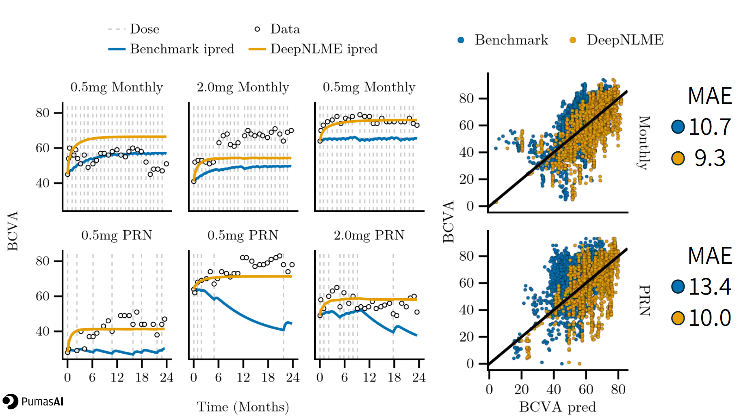
CASE 03 · OPHTHALMOLOGY · RESULTS
CASE 03 · OPHTHALMOLOGY · RESULTS
DeepNLME outperforms the parametric benchmark — especially on unseen dosing
DeepNLME outperforms the parametric benchmark — especially on unseen dosing
Held-out PRN cohort: Day-1 posterior MAE 13.4 → 10.0 BCVA letters — DeepNLME generalizes where the parametric model breaks.
Held-out PRN cohort: Day-1 posterior MAE 13.4 → 10.0 BCVA letters — DeepNLME generalizes where the parametric model breaks.
Monthly cohort MAE (Benchmark / DeepNLME): 10.7 / 9.3. PRN cohort MAE: 13.4 / 10.0. Soubret A et al., ACoP 2024.
Monthly cohort MAE (Benchmark / DeepNLME): 10.7 / 9.3. PRN cohort MAE: 13.4 / 10.0. Soubret A et al., ACoP 2024.
SciML in Drug Development · Amit Roy · University of Nebraska, April 2026
SciML in Drug Development · Amit Roy · University of Nebraska, April 2026
28 / 37
28 / 37

Slide 29
CASE 04 · ONCOLOGY · WHY IT'S HARD
Phase 1/2 data can't directly answer the OS question
WHAT WE WANT
WHAT WE HAVE
Overall Survival (OS) — the gold-standard efficacy endpoint
Tumor response (RECIST objective response rate · ORR)
Hard endpoint, not a surrogate
Small N — typically 30–200 patients
Required for full approval in most indications
Short follow-up — months, not years
Decision-grade evidence for sponsors and payers
ORR-to-OS conversion is empirically uncertain
Go/no-go decisions for Phase 3 must be made before OS is observable.
SciML in Drug Development · Amit Roy · University of Nebraska, April 2026
29 / 37

Slide 30
CASE 04 · ONCOLOGY · MIDD APPROACH
TGI-OS modeling — bridging tumor dynamics to overall survival
1
2
3
4
SLD time course
Fit TGI model
Extract metrics
Link to OS
Longitudinal sum-of-longest-diameters(SLD)
from serial CT scans
Stein / Claret bi-exponential
mechanistic form
KG (growth), TTG, nadir,
%ΔSLD
Survival model (Cox / Weibull)
using metrics as covariates
WHAT THIS BUYS YOU
Mechanistic interpretation — tumor response should map to biology
Used to predict Phase 3 OS from Phase 1/2 SLD — used to inform Go/No-Go decisions
But: parametric form constrains the SLD trajectories you can fit
Stein WD et al., Oncologist 2008 · Claret L et al., JCO 2009 · Bruno R et al., CPT:PSP 2019
SciML in Drug Development · Amit Roy · University of Nebraska, April 2026
30 / 37

Slide 31
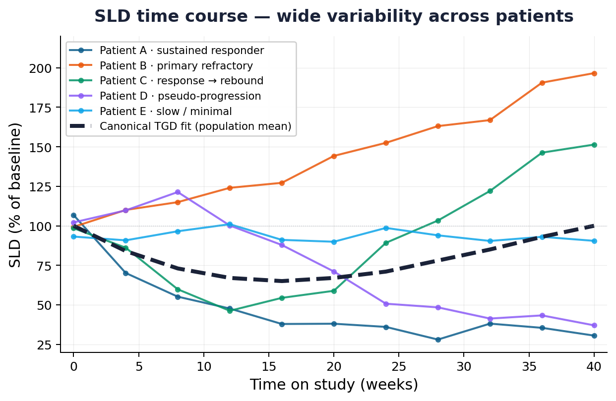
CASE 04 · ONCOLOGY · WHY MORE FLEXIBILITY HELPS
Real SLD trajectories are noisy — and a canonical TGD model misses the diversity
Five patients, five different SLD shapes that are challenging to describe with a canonical TGD model
Illustrative reproduction adapted from TGI-OS literature (Stein WD et al., Oncologist 2008; Claret L et al., JCO 2009)
SciML in Drug Development · Amit Roy · University of Nebraska, April 2026
31 / 37

Slide 32
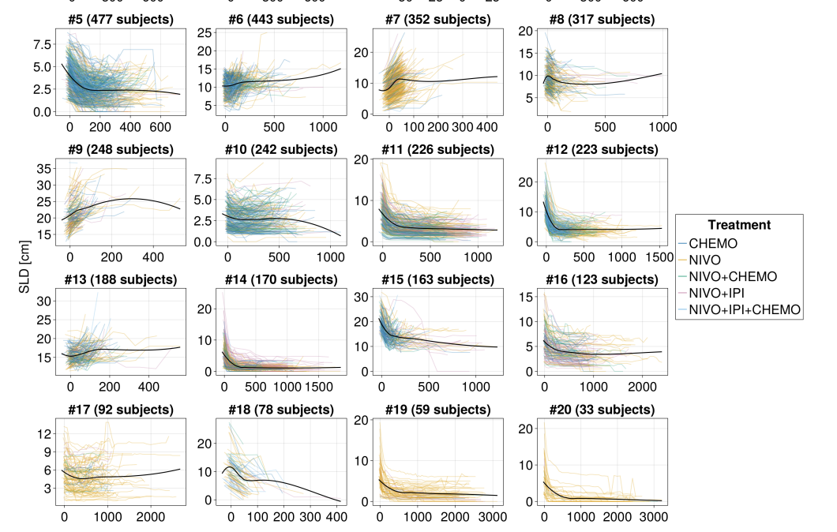
CASE 04 · ONCOLOGY · SCIML APPROACH
SciML captures complex SLD patterns the parametric form misses
Subjects were clustered by their
SLD profiles to understand the value of the
DeepNLME model for different TGD profiles (selected profiles shown)
Tarek M et al., A DeepNLME-based Tumor Growth Dynamics and Overall Survival Model for Non Small Cell Lung Cancer— ACoP 2024, Phoenix, AZ
SciML in Drug Development · Amit Roy · University of Nebraska, April 2026
32 / 37

Slide 33
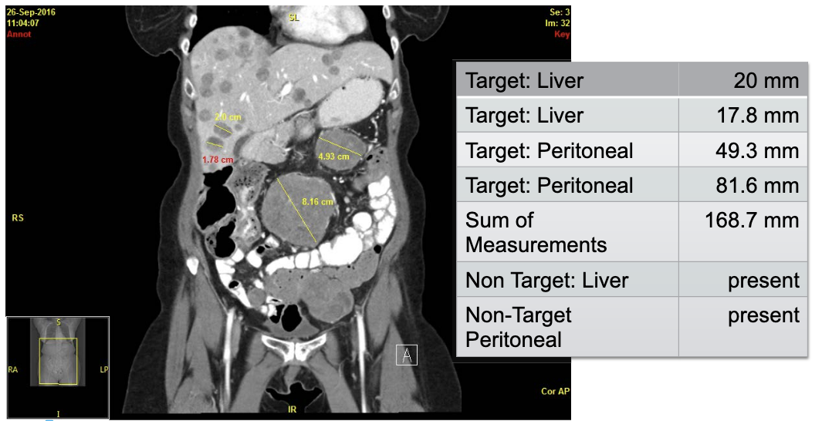
CASE 04 · ONCOLOGY · THE DATA REDUCTION
From CT scan to SLD — every step throws away signal
WHY SLD LEAVES INFORMATION ON THE TABLE
CT scan
Target lesions
Segmented
Sum diameters
rich 3-D imaging
≤ 5 selected per RECIST
spatial structure preserved
single 1-D number / visit
CONCRETE EXAMPLE:
A SINGLE CT SLICE
Image taken from: Okuno S., RECIST: New CRA Orientation Alliance (2016)
SLD = sum of 4–5 longest diameters — non-target lesions, spatial heterogeneity, texture and necrosis are dropped.
SciML in Drug Development · Amit Roy · University of Nebraska, April 2026
33 / 37

Slide 34
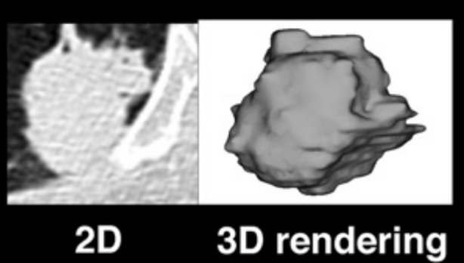
CASE 04 · ONCOLOGY · LOOKING AHEAD
Next frontier — direct image-based TGI models
IMAGE-BASED TUMOR SCIML
WHAT THIS COULD UNLOCK
Foundation models on CT/MRI
Earlier, more reliable predictions of OS
UDE in image-embedding space
OS informed by tumor burden, lesion location & heterogeneity
End-to-end CT → OS prediction
WHAT IMAGE-BASED MODELS SEE
Use the full data — not just a single number.
Image taken from: Dercle L, et al, Clinical Cancer Research (2020)
SciML in Drug Development · Amit Roy · University of Nebraska, April 2026
34 / 37

Slide 35
FOR GRAD STUDENTS
Skills worth investing in — whatever your subfield
Modeling language
Differential equations
Pharmacometrics
Julia (Pumas/SciML) or Python (JAX/PyTorch). Pick one, go deep.
ODEs, dynamical systems, sensitivity analysis — the bridge to ML.
Compartmental PK, NLME, VPCs. SciML extends — doesn't replace.
Responsible ML
Read across two fields
Communicate clearly
Train/test discipline, calibration, uncertainty, fairness.
CPT & CPT:PSP — and NeurIPS / ICML / JMLR for SciML methods.
The model that gets used is the one a clinician can interrogate.
SciML in Drug Development · Amit Roy · University of Nebraska, April 2026
35 / 37

Slide 36
CONCLUDING THOUGHTS
Three takeaways
01
AI/ML is now part of the clinical-pharmacology toolkit
It's no longer a research curiosity — 300+ FDA submissions, multiple regulatory guidances, and active programs at virtually every major sponsor confirm this. The right question isn't 'whether,' it's 'where and how.'
02
SciML is the bridge between what we know and what data can teach us
Pure ML alone can't replace pharmacometrics — it can't extrapolate, it ignores physiology, and it isn't trustworthy outside its training distribution. SciML keeps the mechanism you trust and learns only the residual.
03
The biggest gains are still ahead
Generative SciML, foundation models for biomarker dynamics, full digital-twin trial simulations, and closed-loop MIDD are all 1–5 years out.
SciML in Drug Development · Amit Roy · University of Nebraska, April 2026
36 / 37

Slide 37
THANK YOU
Questions & discussion

